Slide 1
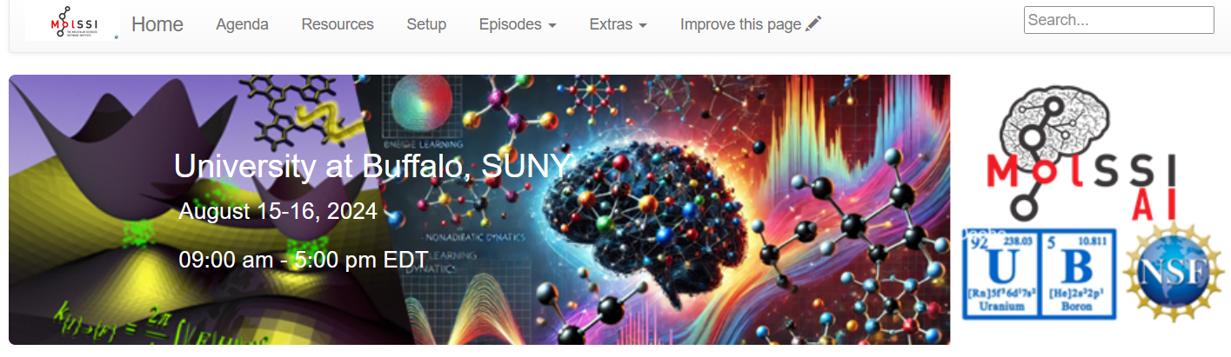
Machine-Learning in
Quantum and Nonadiabatic Dynamics
(Credit: Mohammad Shakiba & ChatGPT)
https://quantum-dynamics-hub.github.io/MolSSI_workshop2024/
University at Buffalo, SUNY, Aug 15-16, 2024

Slide 2

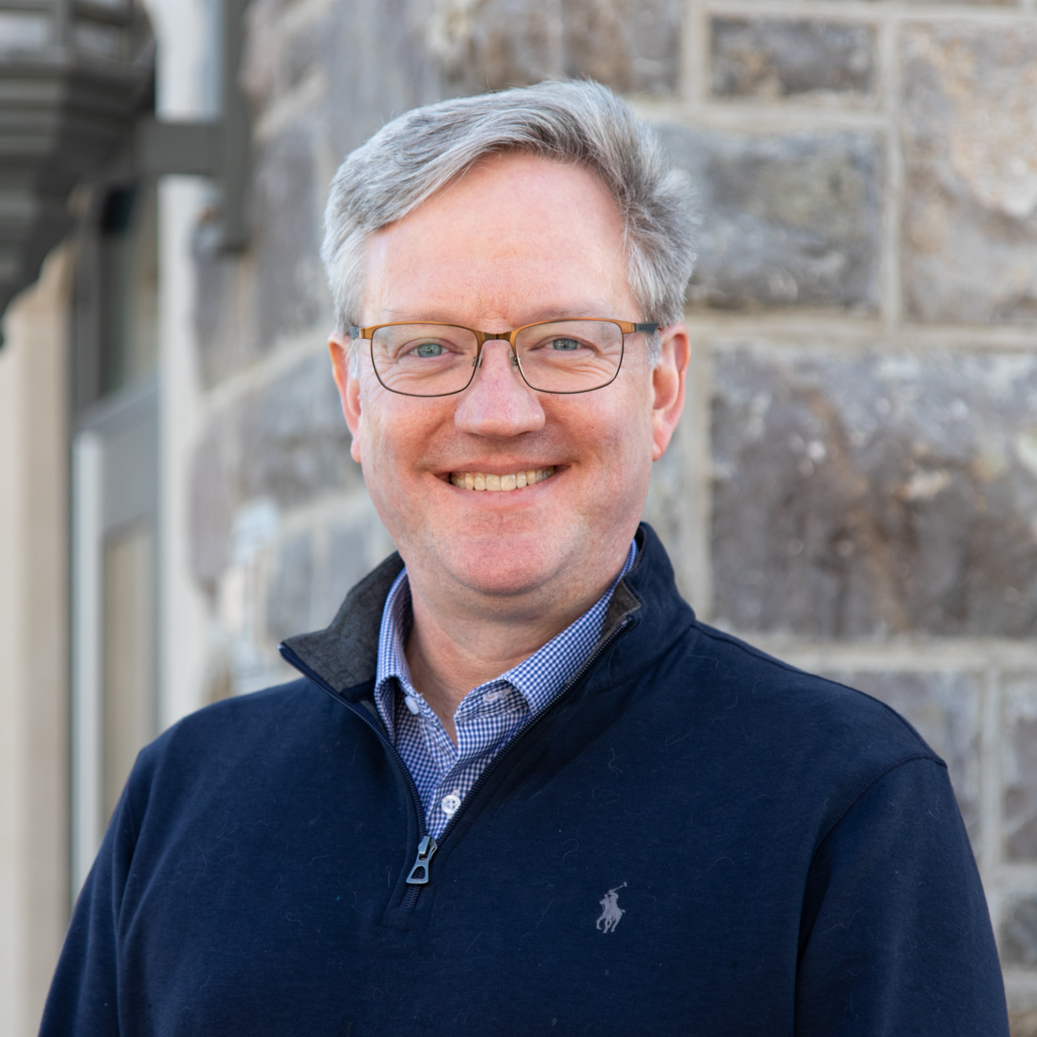


Objectives of this Workshop
https://molssi.org/
Daniel Crawford – director of MolSSI
Objectives:
Awareness: learn about the new/best practices of using ML in electronic structure, quantum dynamics, and related simulations
Interdisciplinary cross-pollination: focus on different closely- or more distantly-related fields – look for common usages, know-hows, and potential problems; share and discuss ideas; educate each other;
Software motivation!!!: learn about practical aspects (codes, software, tutorials) of such calculations – one of MolSSI’s mission. Try to be practical.

Slide 3
Working Plan
Hybrid format: in-person + Zoom
Join Slack:
https://join.slack.com/t/quantumdynamicshub/shared_invite/zt-mjbhjssx-GGhsbYHxeBMvhmumK_j7LA
Please provide your input:
Google Docs: https://docs.google.com/document/d/1D8pYIUbMmg3Nx45jb6nTULSxjGsXQsdsf0jxeMc07tY/edit?usp=sharing
Slack: https://join.slack.com/t/quantumdynamicshub/shared_invite/zt-mjbhjssx-GGhsbYHxeBMvhmumK_j7LA
* Please use the #molssi-2024 channel
WeChat: ???
Work in small groups in the breaks – also remote participants
The summary of the working documents will be made available on the Website
Lectures will be videorecorded, abstracts and presentations will be made available via the Website

Slide 4
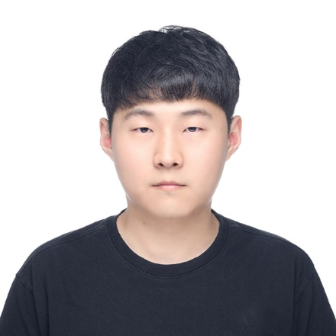
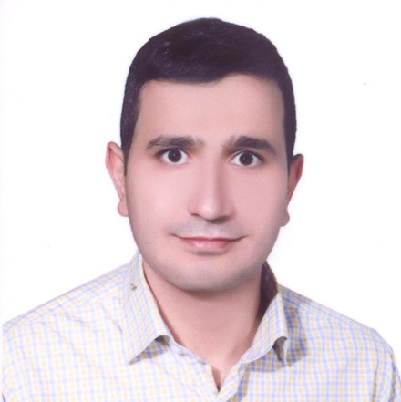
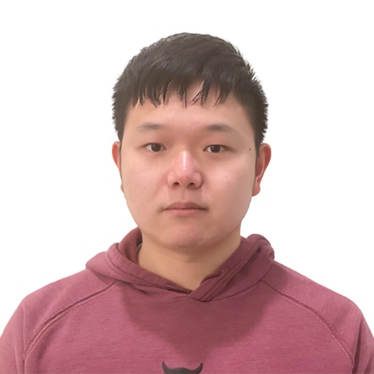
Organizers and Helpers
Daeho Han
Alexey Akimov
Mohammad Shakiba
Qingxin Zhang

Slide 5
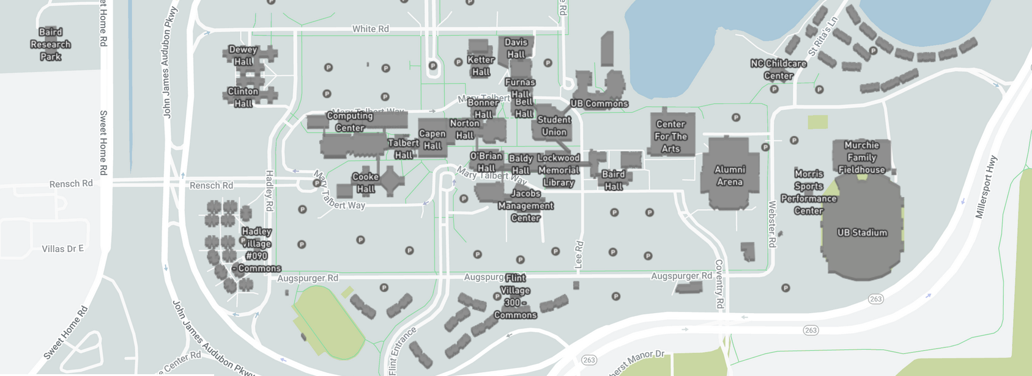
Daily Schedule
Daily
Breakfast = hotel
9:00 am – 12:00 pm: Morning session (Recording)
12:00 – 1:30 pm Working lunch/rest – on your own at “Commons” or “World Cafe”, rest, discuss, collaborate
1:30 pm – 5:00 pm: Afternoon session (Recording)
After 5:00 pm: collaborations/on your own, dinner on your own
Eat here
Location
Aug. 15 – Baldy Hall 200G
Aug. 16– Clemens 120
Your hotel plaza
Campus Map: https://www.buffalo.edu/home/visiting-ub/map.html

